Slide 1
Ghostbusters (2016) Game Evaluation Report
May 15, 2019
Marjorie Ann Cuerdo
Frauline Agarin
HCI 590: Games User Research
DePaul College of Computing and Digital Media

Slide 2
Overview
(Click on links below to jump to respective sections)
Executive Summary
Competitive Review
Heuristic Review
Usability Test
Playtest

Slide 3
Main Research Objectives
Why was Ghostbusters (2016) received poorly by players?
How does the game compare to its competitors?
What usability issues do players encounter?
Is the game player experience enjoyable for players?

Slide 4
Executive Summary
Ghostbusters (2016) is a twin-stick action shooter video game. We examined the game on the Xbox One platform through four stages.
Competitive Review
Tier 1 competitors were other Ghostbusters-themed games.
Tier 2 were other movie-based third-person action shooters.
Tier 3 were other purely top-down isometric third-person action shooters.
We found that Ghostbusters (2016) was unique in being the only movie-based top-down isometric third-person action shooter, apart from Reservoir Dogs: Bloody Days (2017).
Heuristic Review
We used Sauli Laitinen’s game heuristics (2008) based on Jakob Nielsen’s heuristics. We found that most of the usability and gameplay heuristics were violated in the game, as the underlying critical issue was that the game’s main goals and objectives were unclear. Lack of appropriate feedback and help to the player can cause confusion as to how mechanics/controls relate to the scoring system.

Slide 5
Executive Summary
Usability Test
Although players felt confident due to the simplified gameplay, this test round confirmed the heuristic review findings that there would be usability issues. Players found objectives, controls/mechanics, and navigating the game user interface and maps to be confusing and detrimental.
Playtest
In assessing the game’s playability, we found that players enjoyed the game’s aesthetics and found AI teammates to be helpful. However, it’s critical that most players found the overall gameplay to be repetitive and not fun, leading them to say the levels were too long. Most players weren’t motivated to continue playing the game after the tutorial level. The major usability issues revealed in the last round were found to result in overall dissatisfaction with the player experience.
We have provided recommendations to specifically address these issues to improve on the foundation that Ghostbusters (2016) currently has for a better player experience.

Slide 6
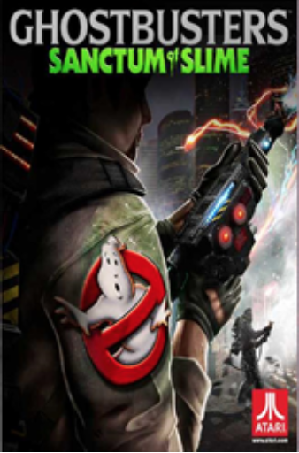

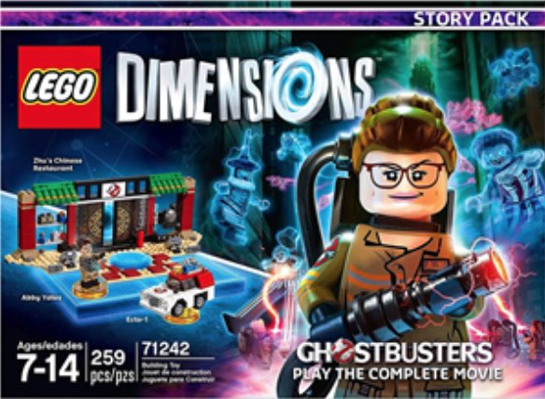
Competitive Review: Tier 1 Competitors Related Ghostbusters franchise games
Ghostbusters: Sanctum of Slime (2011)
Co-op twin stick shooter
Local and online co-op multiplayer modes
AI teammate options
No weapon upgrades
No cutscenes or voice narration
2. Ghostbusters: The Video Game (2009)
Third-person shooter (Nintendo DS is top-down)
Local and online multiplayer modes
Weapon upgrades available
3 difficulty levels: normal, experienced, professional
Uses same characters from Ghostbusters II
Lego Dimensions: Ghostbusters Story Pack (2016)
Action-adventure 3D platformer
2-player local co-op
Weapon and character upgrades available
Uses same characters from Ghostbusters (2016)

Slide 7


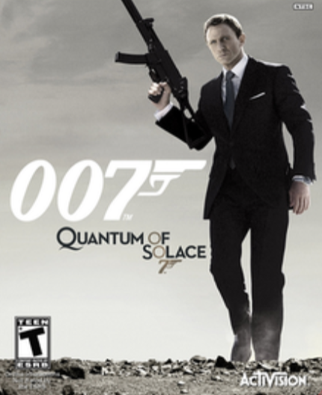
Competitive Review: Tier 2 Competitors Movie-based action shooter games
Reservoir Dogs: Bloody Days (2017)
Top-down isometric third person shooter
No multiplayer modes; 1 player for 3 characters
Defeat enemy waves for every level
No cutscenes or voice narration
2. Star Wars Battlefront II (2017)
Switch between third- and first-person
Campaign: solo; has other multiplayer modes
Has player upgrades
3 difficulty levels: explorer -> soldier -> special forces
Uses same characters from franchise and cutscenes
007: Quantum of Solace (2008)
First-person: PC, PS3, Xbox 360
Third-person: Nintendo DS and PS2
2-4 players in local and online co-op multiplayer (Wii)
Weapon and character upgrades available
Uses voice acting, dialogue, and events from movies

Slide 8
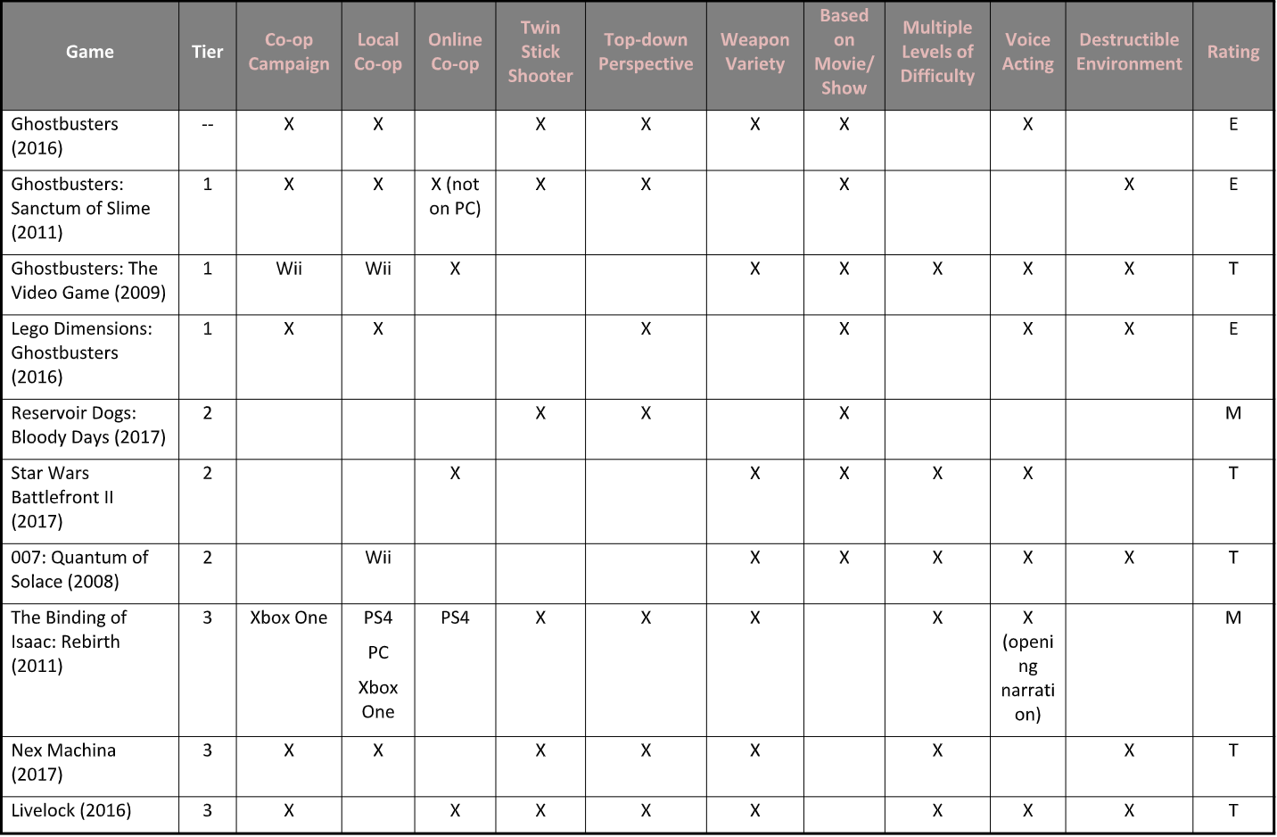
Competitive Review: Summary

Slide 9
Heuristic Review
We used Sauli Laitinen’s game heuristics (2008) based on Jakob Nielsen’s heuristics. These heuristics are split between usability and gameplay.
We found that most of the usability and gameplay heuristics were violated in the game:
Goals/objectives are unclear throughout the game
The relationship of mechanics to the scoring system is unclear
Lack of feedback and available help/assistance to player when they are confused
Tasks are repetitive and monotonous, throwing off the game’s challenge and pacing

Slide 10
Usability Test
Main Research Goals
Assess effectiveness of game UI
Identify interaction issues in the following game activities:
Complete the tutorial level (“Gertrude’s Revenge” in “Aldridge Manor Level”)
Upgrade character skills
Complete the post-tutorial level (“St. Lou’s Cemetery Level”)
Research Questions
Can players start new games?
Can players move their character?
Can players roll to dodge attacks?
Can players shoot/attack with their main weapon?
Can players throw bombs?
Can players cool off their overheated weapon?
Can players be revived by teammates?
Can players capture main ghosts/bosses?
Can players upgrade their character’s skills?
Can players navigate to required checkpoints in a level?
Can players find the next level?

Slide 11
Usability Test: Participants
Four participants who were in the range of 21-28 years old.
Participants were screened for:
They are at least 18 years old.
They have played on Xbox before (this was the available console for testing).
All participants had played shooter games before – 3 rating their skills average; 1 excellent.
3 out of 4 participants typically played games for 30-60 minute sessions; 1 for 60-90 minutes.
3 out of 4 participants rated their competitiveness as average; 1 rated theirs very high.
Commonly played games genres were RPGs and first-person shooters (FPS).

Slide 12
Usability Test: Prioritization
Positive issues indicate good practice, where the feature worked as intended.
Critical issues are those that occured on a core task, were not easy to overcome, and occured persistently for the same user. Fix urgently.
High issues met two of the criteria of occuring on a core task, being hard to overcome, or occuring persistently.
Medium issues either occurred on a core task, were hard to overcome, or occured persistently.
Low issues were usability issues that met none of the criteria, but too many of them will impact people’s perception of the experience.
Positive
Critical
High
Medium
Low

Slide 13
Highlights

Slide 14
Usability Test:
Positive
Participants did not think the game was unnecessarily complex.
(3 out of 4 participants)
In the post-test questionnaire, participants were asked to rate their agreement from 1-5 (1 = strongly disagree, 5 = strongly agree) with the statement: “I found the game unnecessarily complex.”
“It’s a pretty straightforward game…”

Slide 15
Usability Test:
Positive
Participants felt fairly confident playing the game.
In the post-test questionnaire, participants were asked to rate their agreement the statement: “I felt very confident playing the game.” The average score for this statement was 3.75.

Slide 16
Usability Test:
Positive
Participants found menu interfaces simple and easy to understand.
3 out of 4 participants were able to select the correct level and start the game without confusion.
“I thought that in general, the menu options were really sort of clear in what I’m doing.”

Slide 17
Lowlights

Slide 18
Usability Test:
Critical
Players don’t know the required objectives in the game.
All participants were frustrated and guessed what their tasks were (e.g. capture bosses, earn points, find secret runes, etc.).
All participants skipped audio that revealed the main ghost to capture.
Learnability problems tied to a high number of unique issues for tasks:
Intro tutorial level: 8.5 issues per player on average
Cemetery level (post-tutorial): 6.75 unique issues per player on average
“I don’t know what I’m supposed to be doing. There are no objectives, literally. Do I just explore the entire mansion?”
“Do I just walk around the cemetery again? I really wish I had objectives!”
“No objectives. No nothing. This is just boring. I don’t know what I’m supposed to be doing.”
“Do we even need to capture these ghosts?”
“Do I need to scan surroundings to make the ghosts appear?”
“What am I supposed to find here?”

Slide 19
Usability Test:
Critical
Recommendations
Players don’t know the required objectives in the game.
Include clear objectives in the game. Examples:
Reaching a certain number of points
Defeating specific enemies
The objectives should be easily accessible in a menu or subtly displayed on screen.

Slide 20
Usability Test:
High
Recommendations
Players don’t understand the points and achievement system.
The points and achievements system were not explained in the introductory tutorial level.
This led to participants not knowing what objects and parts of the game they should interact with.
“Are these points for us?”
“I don’t even know [about getting points]. I think it correlates to the upgrade points. I didn’t even know it mattered.”
“I’m assuming these points are what you use to upgrade but the fact is, it didn’t connect to me if I could get more points, I could really get more cooler upgrades. There was no incentive for me to press rapidly for the trap. There was no incentive for me to go search out these things. I don’t even know what the 2 out of 4 thing is. It’s like okay, I found it I guess, by accident. It’s not like I specifically went out and looked for it.”

Slide 21
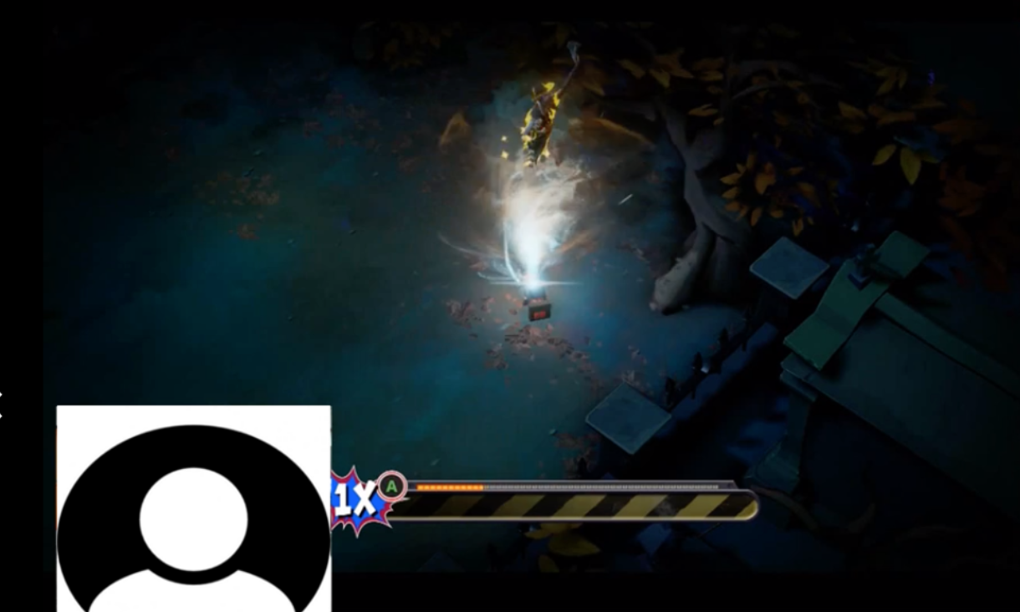
Usability Test:
High
Recommendations
Players don’t understand the points and achievement system.
In the tutorial, include explanations and descriptions of the points and achievements system.
Introduce what objects and parts of the game players can interact with.
Provide clear visual and audio feedback when objects are interacted with.
Participant 2 ignores the bonus points multiplier mini-game closer to the end of the gameplay session.

Slide 22
Usability Test:
High
Players had trouble keeping track of the multiple indicators for a character’s health and weapon status with the layout on the screen.
“It’s hard to keep track of overheating because I’m looking at where my bullets are going and not my character. There should be a crosshair…”
(After realizing the circle that is under character is a grenade cooldown indicator) “I didn’t know that! It would be nice if they’d let me know.”
“It’s really hard to tell who’s firing what and who’s who when we’re all bunched up together. They just look too the same. It’d be nice if they each had a different color palette… I keep instinctively looking at everyone else.”
“I really would’ve liked if all of the health was on the same side so it’s easier to keep track of them. Kinda like how in traditional games, if you have a party system, everybody will be on the left.”
“I wish the bomb cooldown indicator was more obvious at the corner of the screen. I’m not gonna be checking the corner for my stats with everything going on on-screen. It’s out of my peripheral vision.”

Slide 23
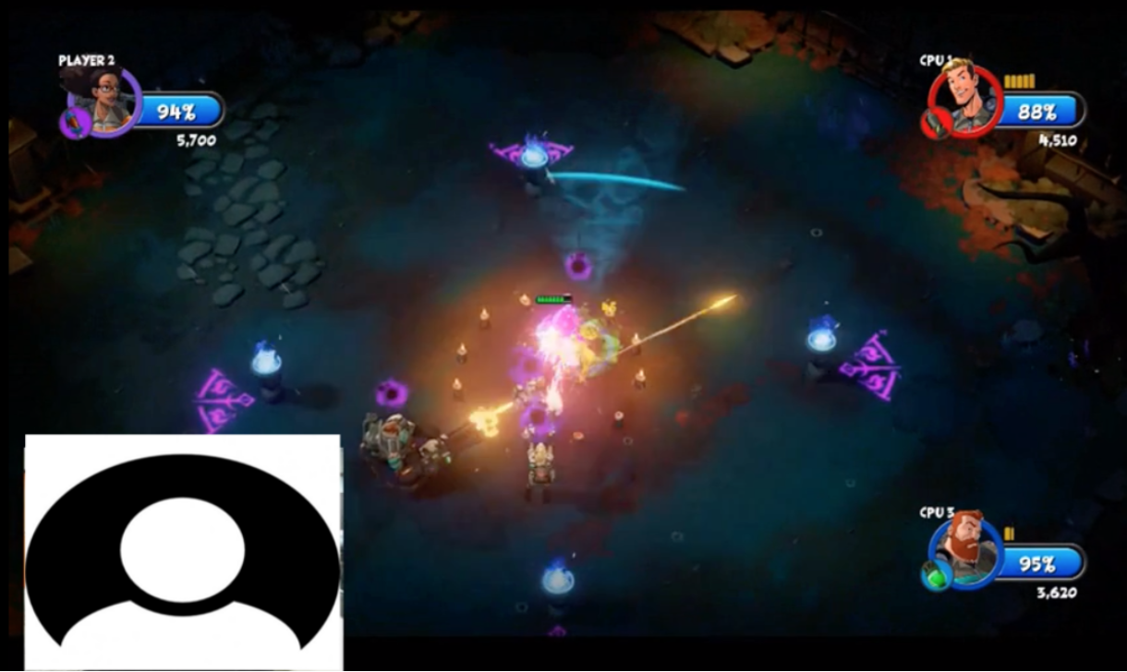
Usability Test:
High
Recommendations
Players had trouble keeping track of the multiple indicators for a character’s health and weapon status with the layout on the screen.
In the tutorial, introduce the cool-down mechanics for weapons and grenades.
Status bars could be distinguished by a glowing effect, increase in size, and or location change.
Consider moving all health bars to one side.
Consider differentiating each character’s appearance more distinctly.
Consider changing health bar to red (as blue is confused for magic/mana).
Participant 2 ignores the bonus points multiplier mini-game closer to the end of the gameplay session.

Slide 24
Usability Test:
High
Players did not understand the mechanic of wrangling and capturing ghosts.
Players couldn’t understand the control indicators and were confused how to capture ghosts. One participant didn’t move the R-thumbstick at all.
“The icon for the ghost slam is confusing because the indicator looks like a damage indicator or showing you where a ghost is… It uses red arrows around the thumbstick icon so it seems like it wants you to spin it around in a circle… kind of confusing.”
“And then when I was trying to capture ghosts, it didn’t tell me I had to tilt it until like my third ghost, that’s when I learned I had to tilt it ‘cause the red arrows are there.”
“From the introduction, they just showed me the key names--like RT and PT(?) stuff--but I really like capture the ghost, grabbing him to someplace, it’s hard! I don’t know what R means of stands for. So I just spent so much of my time. Then I realized that it’s the remote stuff.”

Slide 25
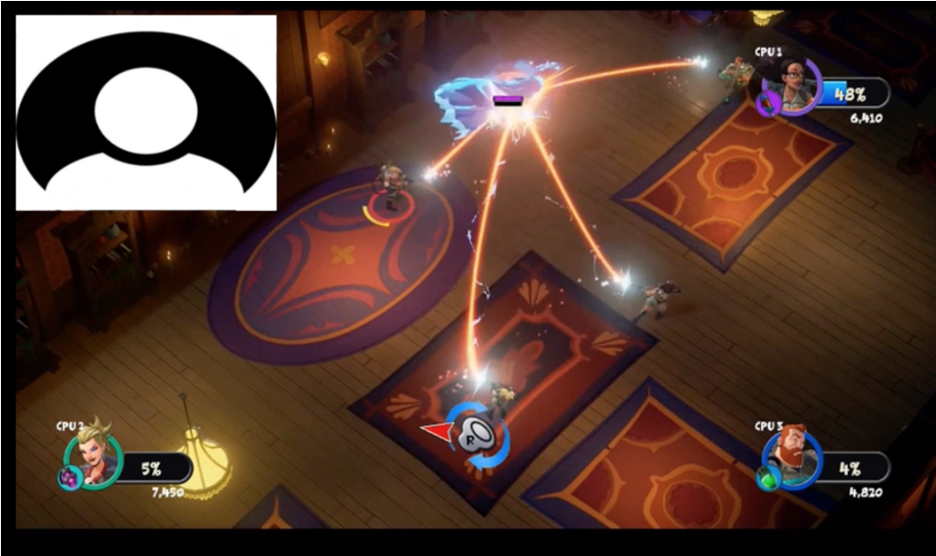
Usability Test:
High
Recommendations
Players did not understand the mechanic of wrangling and capturing ghosts.
In the tutorial, clarify thumbstick control motions for wrangling, slamming, and capturing ghosts.
Consider adding audio and/or text instructions during the first few times the player has to capture a ghost.
Participant 1 did not understand what the right thumbstick indicator meant on the bottom of the screen.

Slide 26
Usability Test:
High
Players do not know how to navigate between checkpoints in the level.
3 out of 4 participants were frustrated about getting lost in the game.
These sentiments were expressed frequently during think-aloud gameplay and interviews.
“Where should I go now?”
“Sorry, wrong way, wrong way.”
“There was no map for me to follow, so I don’t know if I’m getting lost by going in a giant circle…. [navigation] was nonexistent.”
“I got lost a lot. I didn’t know where I was going. I had to use the runes… and I guess the runes were leading me to secret areas, optional objectives… I didn’t really feel that confident when playing.”

Slide 27
Usability Test:
High
Recommendations
Players do not know how to navigate between checkpoints in the level.
In the tutorial, consider introducing or hinting that there’s a way to hold down the B button to reveal the correct path.

Slide 28
Usability Test:
High
Players were not able to successfully upgrade their characters.
All players accidentally skipped spending their earned skill points for upgrades.
All thought pressing A button would add skill points, but it skipped the screen into next level. Only 2 participants noticed their mistake while the others did not.
“Upgrading character -- so I had a problem with this. I pressed A when I thought I was spending points, but it was supposed to be X. I guess it’s just the way it was shown… like A was next to go to the thing. I thought A was to spend the points.”
(Researcher: So it skipped past that you weren’t able to do A?)
“Yeah, so I didn’t even see where my points were spent. I didn’t even spend them! So yeah, that’s why my character was so slow. So that wasn’t great either.”
“Definitely had issues the first time considering I didn’t spend any points, then I just moved on to the next level. I think I may have been rushing, but that’s how I play games anyway. I’m used to it being, where if there are no problems, then it must be really intuitive. So it didn’t prompt me at all on how to allocate my skill points. I swear the only button I saw on the screen was A on the bottom left, so I thought ‘okay A is allocate points.’ And I clicked it once and it said, ‘Ready?’, and I thought it just was a fun way of being like, ‘Are you sure you want to allocate points?’ And I was like ‘yes’. I hit A, and then it was ‘Next level’ and I was like oh my god!”

Slide 29
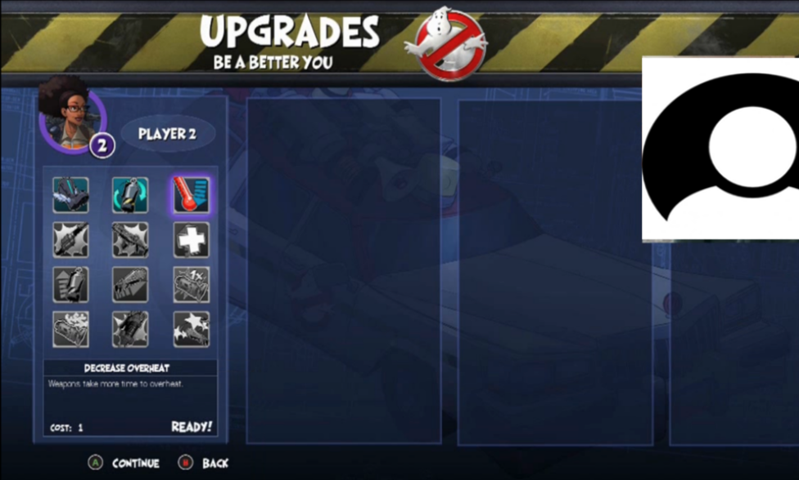
Usability Test:
High
Recommendations
Players were not able to successfully upgrade their characters.
A dialog could pop-up when they are going to move to next level without spending skill points yet, such as:
“You haven’t spent your skill points to upgrade your character yet! Are you sure you want to skip this?”
Consider making buttons more distinguishable visually and/or changing their position from the bottom of the screen.
Participant 3 thought that “Ready!” after pressing A was a confirmation statement to add points.

Slide 30
Usability Test:
Medium
Players were not able to distinguish between enemy types and abilities.
Players didn’t know which enemies were grunt-types, mini-bosses, or big bosses.
They did not know which ghosts were capturable and why (or why not).
“I really wish you could tell which ghosts are capturable before they have purple health cuz I would prioritize them.”
“What’s that shadow ball? Is that a curse on me?”
“And then the gold enemies, I still don’t know what they do because some had auras and some didn’t.”

Slide 31
Usability Test:
Medium
Recommendations
Players do not know how to navigate between checkpoints in the level.
Consider introducing or at least signifying new enemy types when they appear.
Consider having player first face the new enemy without other already known enemies around so that they have time to adapt to new changes before a more difficult battle.
Consider explaining what different colors in enemy auras mean.
Consider making a visual difference between capturable ghosts and those that are not.

Slide 32
Usability Test:
Medium
Players did not know which weapon was currently selected and how to switch.
3 out of 4 participants expressed confusion about how to switch weapons and knowing which they were currently using.
“...so upset at using the proton beam for everything, ‘cause I didn’t realize that I had accidentally swapped away from my default weapon by accident.”
“Yeah the controls are weird for me because I was confused that this was supposed to throw grenades. I thought it was supposed to switch weapons, but it was this one. And then this one was to not heat up weapons so I thought maybe this should be change your weapon and this could be not overheat your weapon. But yeah, it was kinda confusing.”

Slide 33
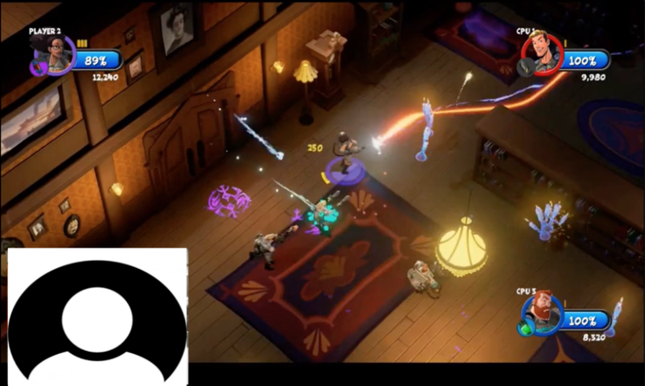
Usability Test:
Medium
Recommendations
Players did not know which weapon was currently selected and how to switch.
In tutorial, consider making players practice switching weapons.
Weapon switching could be made more visible by animate the action and enlarging the weapon temporarily.
The weapon icon on the player’s status icon could be bigger and colors more distinct.
Participant 2 (“Player 2”) is shooting at the enemy with the proton beam, which does not damage most
enemies.

Slide 34
Usability Test:
Medium
Players did not understand the grenade mechanics.
All players said they didn’t fully understand how the grenade works.
“Some features like the grenade, I never used because I was not 100% sure how to-- how it worked. Sometimes, it didn’t seem to detonate; sometimes it did detonate. Sometimes it bounced. And sometimes, it didn’t. I think it said I could press the left trigger again to detonate, but I tried that, and it didn’t seem to work, so I just didn’t really use the grenade.”
(Researcher: Did you expect that you had to collect them or…?)
“...I thought that they respawn… Do they respawn?
(Researcher: Yes)
I didn’t even know when they’d respawn. I’d just press the left trigger whenever.”

Slide 35
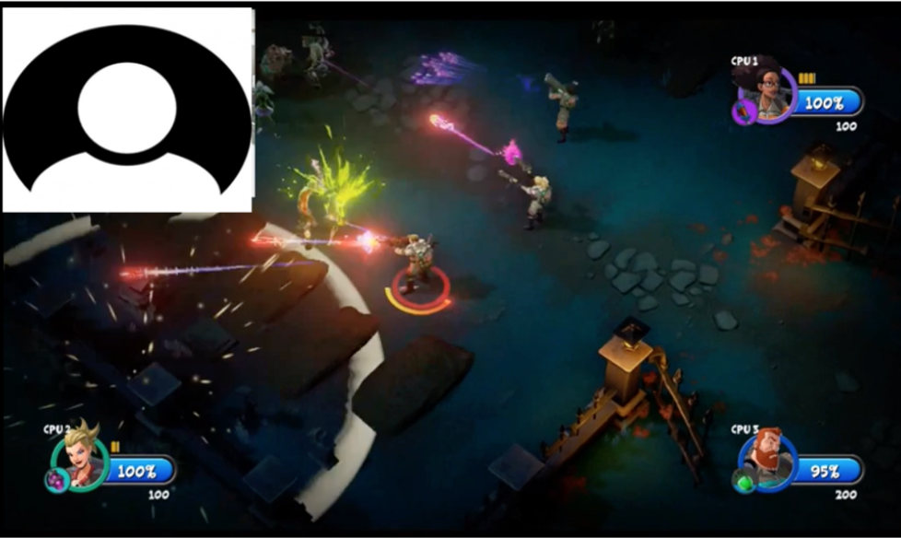
Usability Test:
Medium
Recommendations
Players did not understand the grenade mechanics.
In tutorial, introduce how grenades work:
Show indicators of when grenades are ready to use.
Consider making player practice throwing the grenade or making one of the first enemies vulnerable to the grenade.
Participant 4 accidentally misfired the grenade and thought that the grenade inventory was lost. They didn’t notice the cooldown indicator directly underneath their character.

Slide 36
Usability Test:
Medium
Players did not understand the scanning indicator of the PKE meter.
3 out of 4 players didn’t know the purpose of the scanning indicator when they used the PKE meter, so thought it was pointless; however, PKE meter is crucial part of game to unlock required areas and enemies to progress.
“Do I need to scan my surroundings to make ghosts appear?”
“And I learned the PKE meter--that was this button--it sucks. Like at the end, I didn’t bother really using it, sort infrequently cuz I know it would prompt me whenever I knew it was very important for me to be able to find it.”
“I guess I’ll just scan everything since I don’t know what to do… Does it mean I need to investigate something nearby?”
“Why even scan if I’m going to get points from everything [attacking enemies] anyway?”
“When you scan you can get those runes, sometimes points will pop out. I noticed that in the cemetery, there were gargoyles that had a red mist spiraling around them and if you scan them, not always but sometimes, a bunch of those ecto or whatever it’s called will fly out and I’d collect it.”

Slide 37
Usability Test:
Medium
Recommendations
Players did not understand the scanning indicator of the PKE meter.
In the tutorial level, ensure players know what the PKE meter is for and what objects it can interact with.
Consider explaining what revealed runes/symbols mean when activated by the meter.

Slide 38
Usability Test:
Low
Players did not understand the team dynamics, such as assists and reviving.
All players just made guesses as to what team dynamics meant, but expressed that they wanted to explicitly know in order to maximize their earned points.
(after seeing “Team Assist - Slimed!” on screen) “Okay, so we can combo with each other? I wish I could control the AI so that we can combo.”
“And what’s this ‘Banished!’ thing? Are those combos?”
(after seeing “Team Assist - Banished!” on screen) “I got a team assist? What does that mean?”

Slide 39
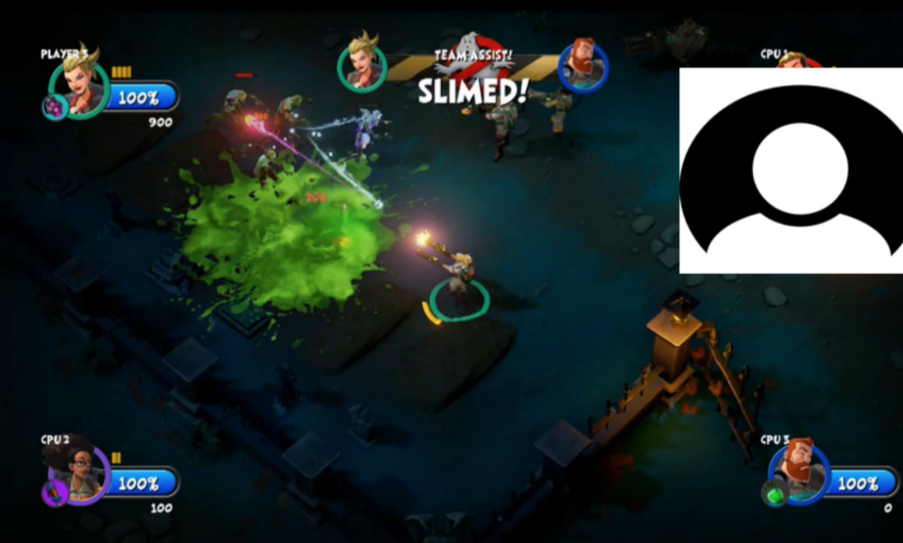
Usability Test:
Low
Recommendations
Players did not understand the team dynamics, such as assists and reviving.
In tutorial level, consider having the player perform a revive and/or assist before moving to the next area of the level.
Participant 3 received the “Team Assist!” pop-up but did not know how they achieved that feat.

Slide 40
Playtest
Main Research Goals
Assess playability of Ghostbusters (2016)
Identify player experience concerns in the following game activities:
Complete the tutorial level (“Gertrude’s Revenge” in “Aldridge Manor Level”)
Complete first level (“Early Mourning”)
Research Questions
How fun did players find the game?
How difficult did players find the game?
How effective was the HUD/GUI?
How did players feel about the pacing of the game?
How effective did players find the control scheme?
How did players feel about the game’s visual and auditory aesthetics?
How likely would players buy and recommend the game to others?

Slide 41
Playtest: Participants
Eleven participants who were in the age range of 20-41 years old.
Participants were screened for:
They are at least 18 years old.
They have played on Xbox before (this was the available console for testing).
Participants rated their action shooter skills an average of 3.27 out of 5.
Participants rated their competitiveness an average of 3.67 out of 5.
Commonly played games genres were RPGs and shooters (FPS).

Slide 42
Playtest: Controls Satisfaction
Method: Mann—Whitney U test
Variable: Controls satisfaction (from mid-test and post-test)
Groups: (1) Beginner action shooter players
(2) Advanced action shooter players
Results: No significant difference found between the groups.
* Perceived skill levels

Slide 43
Playtest: Difficulty
Method: Mann—Whitney U test
Variable: Difficulty (from mid-test and post-test)
Groups: (1) Beginner action shooter players
(2) Advanced action shooter players
Results: No significant difference found between the groups.
* Perceived difficulty

Slide 44
Playtest: Fun
Method: Mann—Whitney U test
Variable: Fun (from mid-test and post-test)
Groups: (1) Lower-competitive players
(2) Highly-competitive players
Results: No significant difference found between the groups.
* Perceived fun

Slide 45
Highlights

Slide 46
Playtest:
Positive
The game’s aesthetics leaned towards positive reception.
Art style: 3.91 out of 5
Voice acting: 3.82 out of 5
Graphics: 3.55 out of 5
Music: 3.55 out of 5
Sound effects: 3.45 out of 5
“The art design was fitting.”

Slide 47
Playtest:
Positive
AI teammates were helpful.
In the post-test survey, participants responded to the question:
”How satisfied were you with the help of AI teammates?”
3.36 out of 5.

Slide 48
Playtest:
Positive
The enemies’ health bars were generally effective.
In the post-test survey, participants responded to the question:
”How effective were the enemies’ health bars?”
3.18 out of 5.

Slide 49
Playtest:
Positive
Shooting controls followed conventions.
In the mid-test survey, participants seemed content with the shooting controls for the game. When asked about what they liked best about controls, “shooting” was mentioned four time.
“The shooting buttons were where you’d expect them to be.”
“Shooting/using weapons LB, RB, LT, RT, were the same as many other games.”

Slide 50
Playtest: Prioritization
Positive issues indicate good practice, where the feature worked as intended.
Critical issues are those that occured on a core task, were not easy to overcome, and occured persistently for the same user. Fix urgently.
High issues met two of the criteria of occuring on a core task, being hard to overcome, or occuring persistently.
Medium issues either occurred on a core task, were hard to overcome, or occured persistently.
Low issues were usability issues that met none of the criteria, but too many of them will impact people’s perception of the experience.
Positive
Critical
High
Medium
Low

